Slide 1
RAILWAYS SYSTEMS
By Pradhyuman Shringi 19UCC073
Sailesh Kumar 19UCC072
Sai Shruti 19UCC088
Rhythm Bajaj 19UCC105

Slide 2
Railways system is example of Mysql Database Connectivity.The Railway Reservation System facilitates the passengers to enquire about the trains available on the basis of source and destination, Booking and Cancellation of tickets, enquire about the status of the booked ticket, etc.
The railway reservation system based on relation model. Example of some SQL queries to retrieves data from rail management database.
BRIEF INTRODUCTION

Slide 3
1)Add_train :used to add train in the train table .only accessed by admin.
2)Admin :used for admin login.
3)Adminpage :navigation page for admin to visit various pages.
4)Book :used to book tickets and add in ticket table.
5)Cancel :used ti cancel the tickets.
6)Del :used to delete user and accessed by admin only.
7)Delete_train:used to delete train from the train table.
8)Home :used for navigation for user just after login.
9)Login :used for login just after creating account.
10)Pnr_status:used for enquiry of ticket booked by user with help of Pnr_no
11)Sign :used for sign up and adding details in user table
12)Train :used for showing the timetable of all train
CLASSES AND THEIR PURPOSE

Slide 4
Database
Schema
User
Ticket
Train

Slide 5
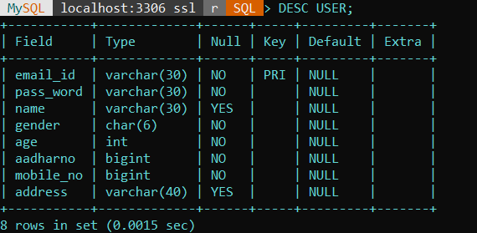
1)USER
create table user(
email_id varchar(30),
primary key(email_id),
pass_word varchar(30) not null,
name varchar(30),
gender char(6) not null,
age int not null,
aadharno bigint not null,
mobile_no bigint not null,
address varchar(40)
);

Slide 6
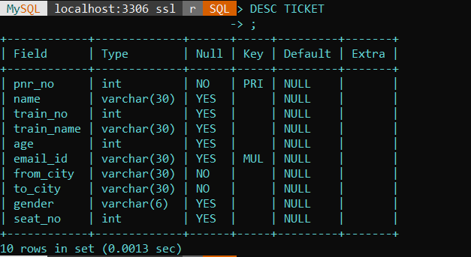
2)Ticket
create table ticket(
pnr_no int,
primary key(pnr_no),
name varchar(30),
train_no int,
train_name varchar(30),
age int,
email_id varchar(30),
foreign key(email_id) references user(email_id),
from_city varchar(30) not null,
to_city varchar(30) not null,
gender varchar(6),
seat_no int
);

Slide 7
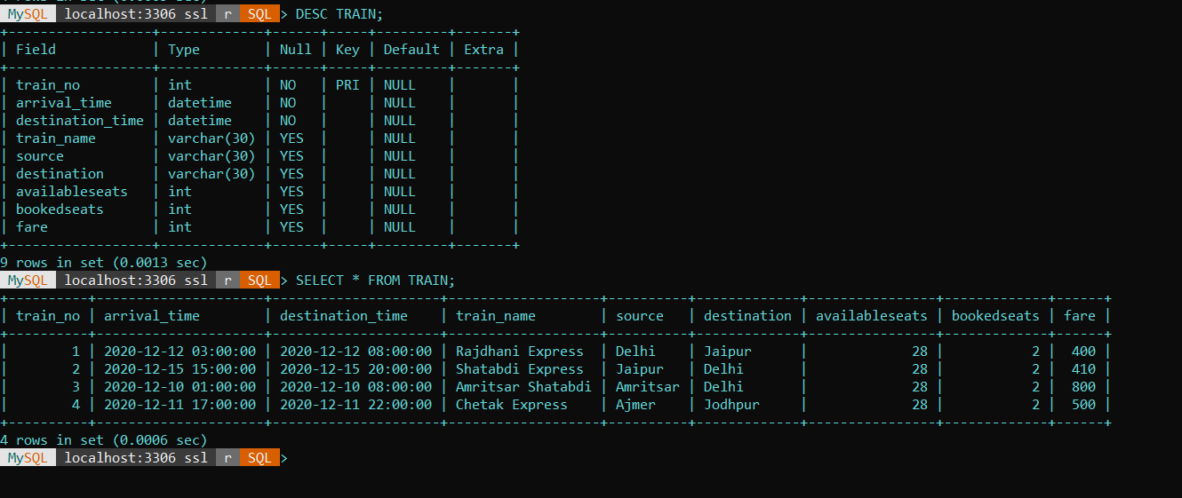
2)Train
create table train (
train_no int,
arrival_time datetime not null,
destination_time datetime not null,
primary key(train_no),
train_name varchar(30),
source varchar(30),
destination varchar(30),
availableseats int ,
bookedseats int,
fare int
);

Slide 8
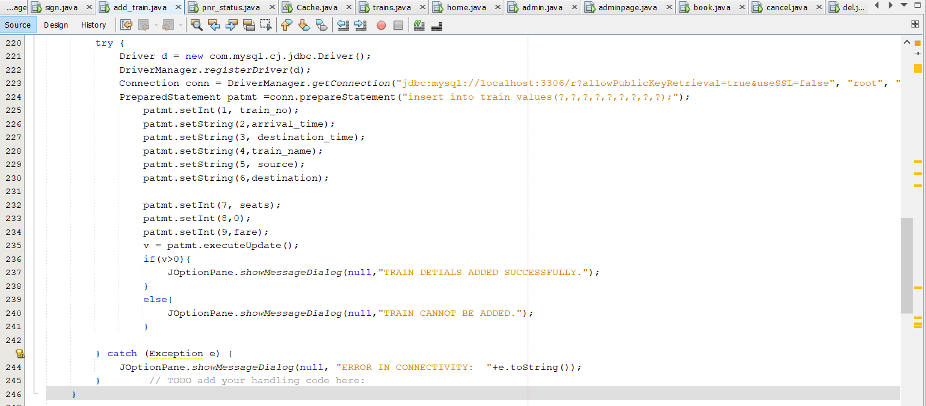
Add Train

Slide 9
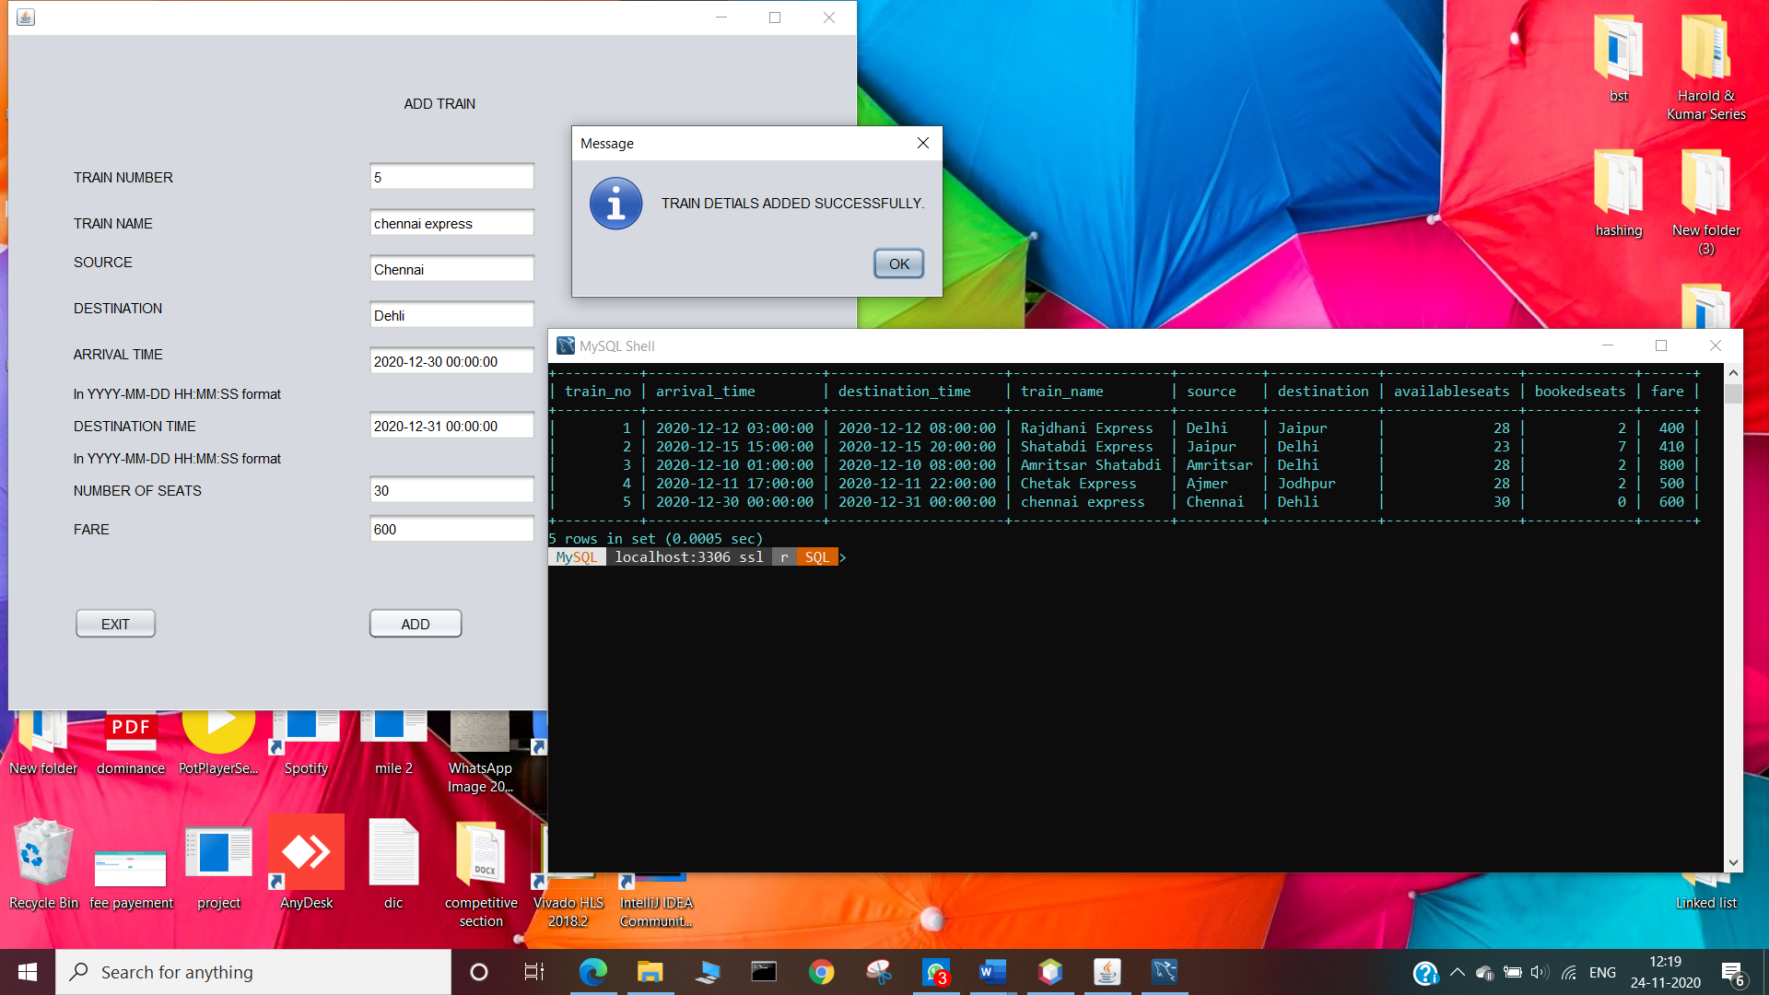

Slide 10
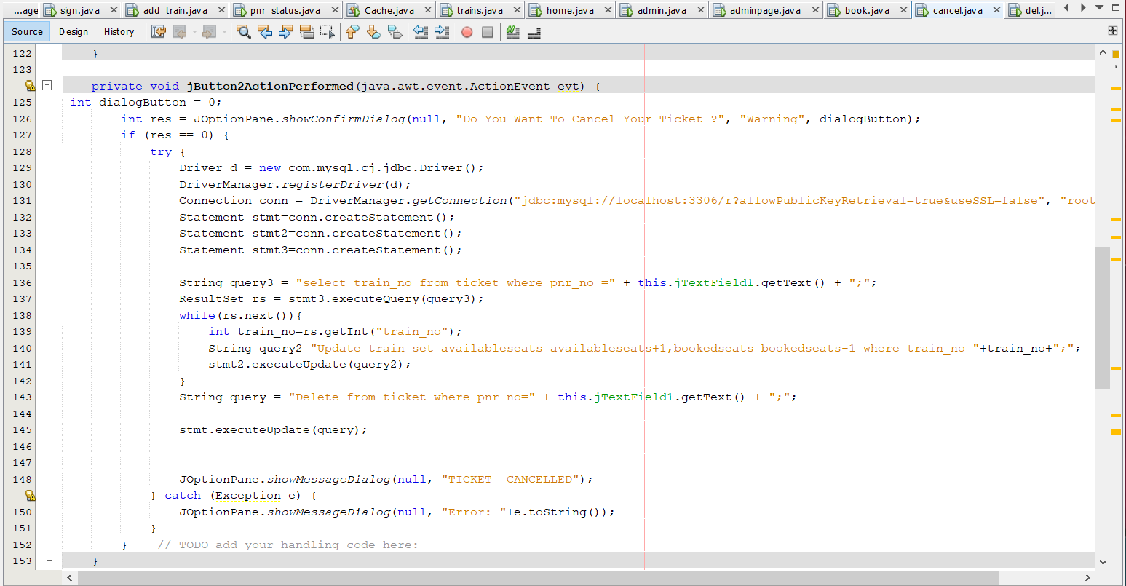
Cancel Ticket

Slide 11
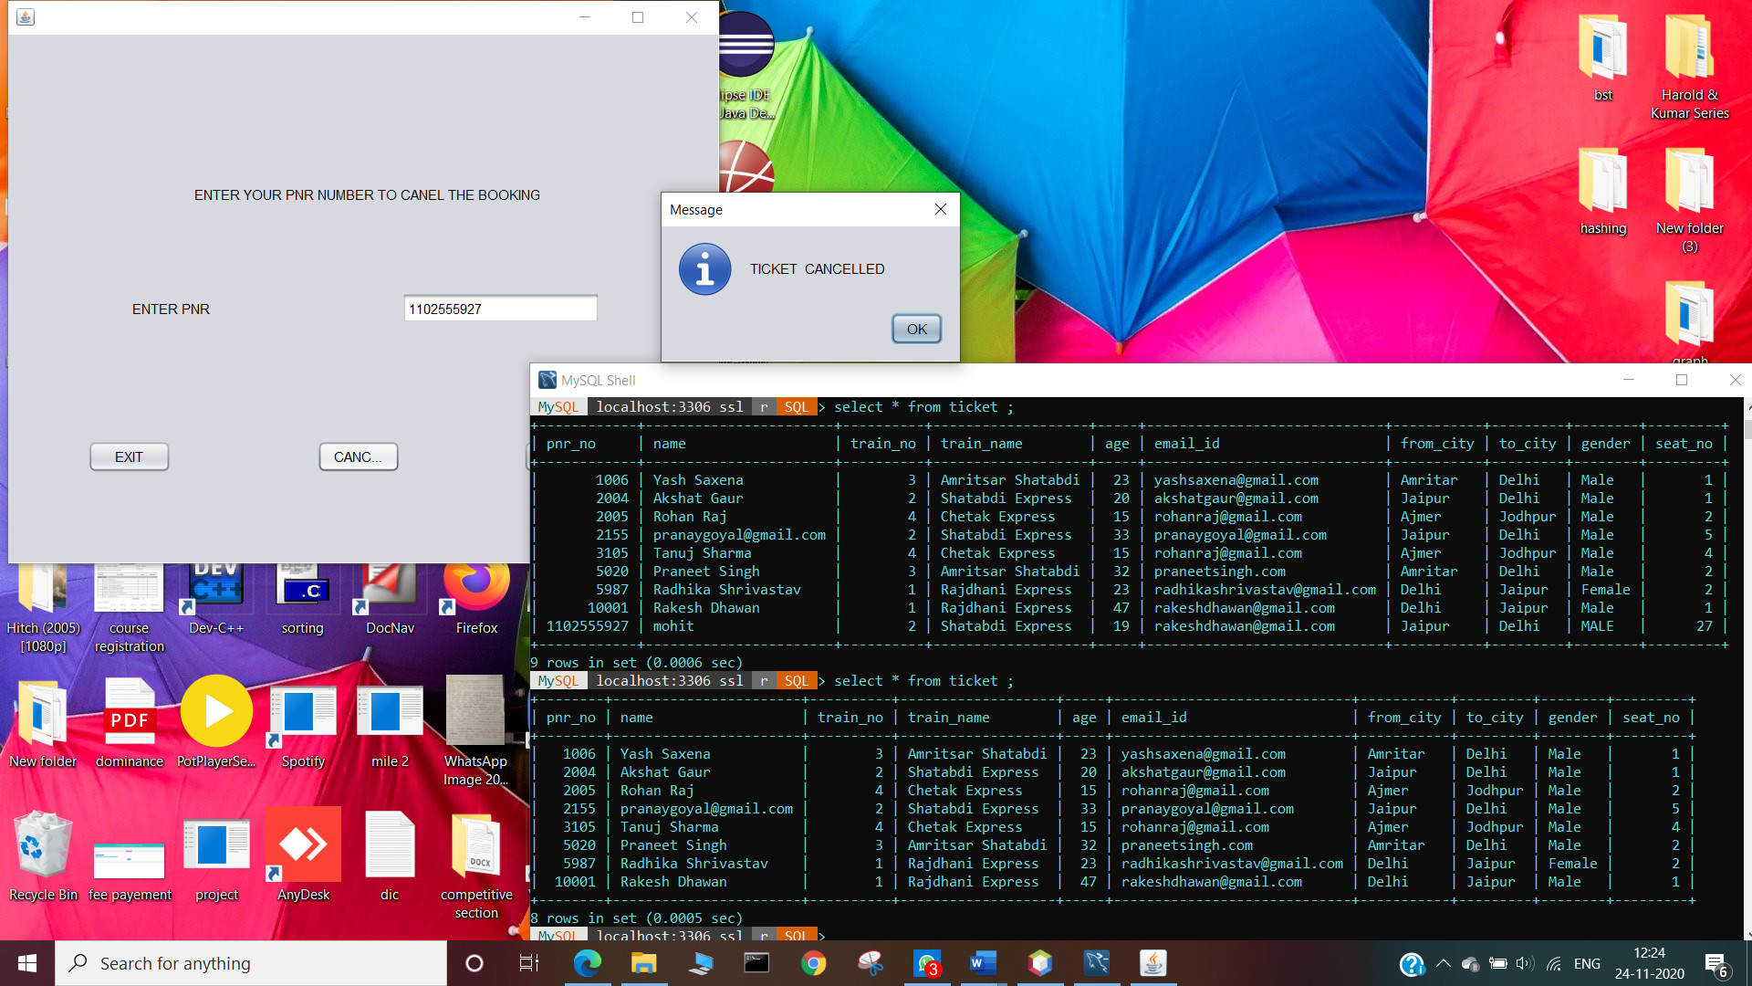

Slide 12
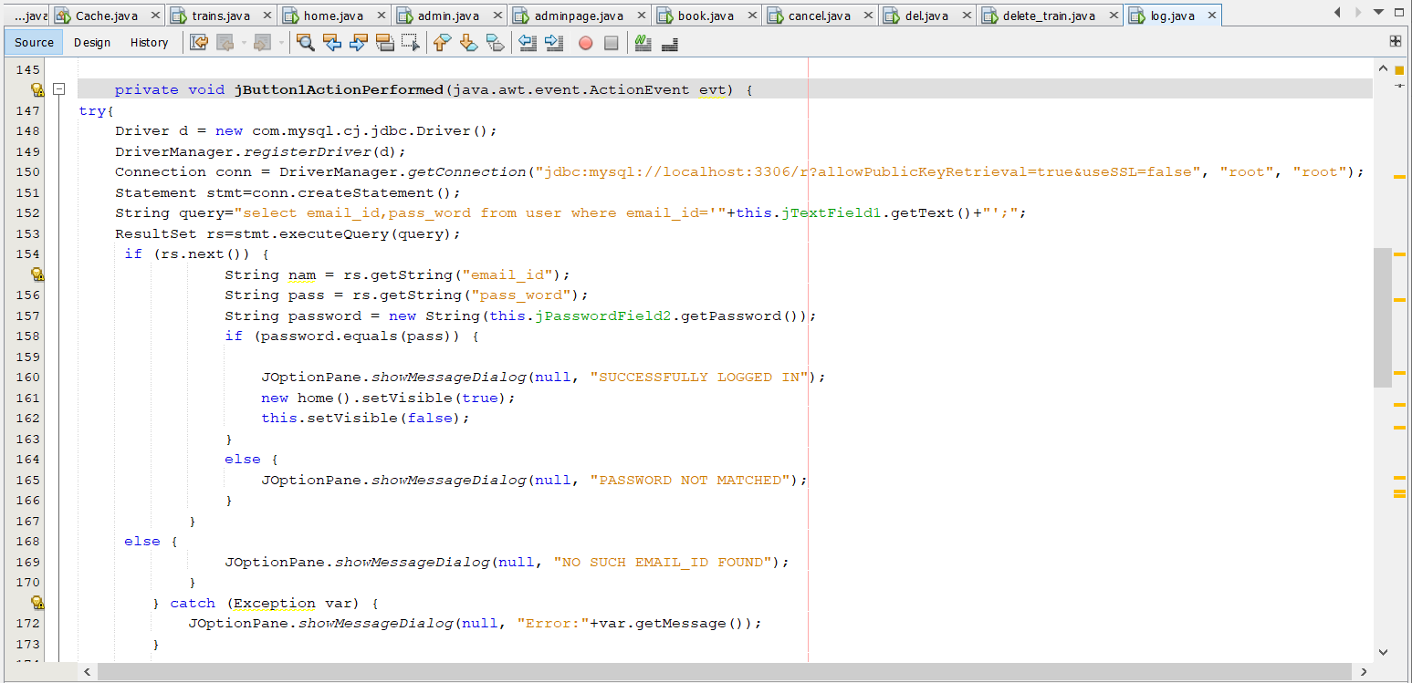
Login Page

Slide 13
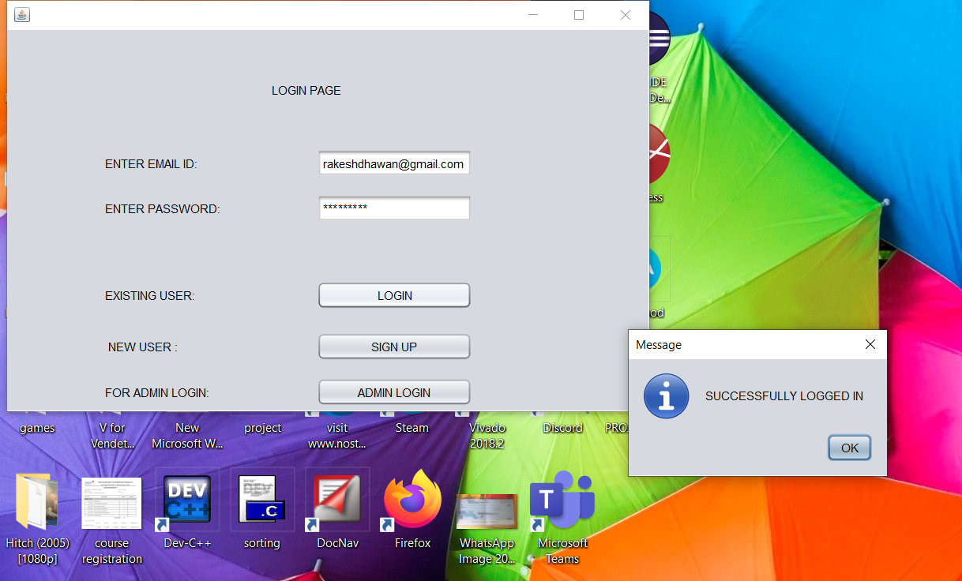
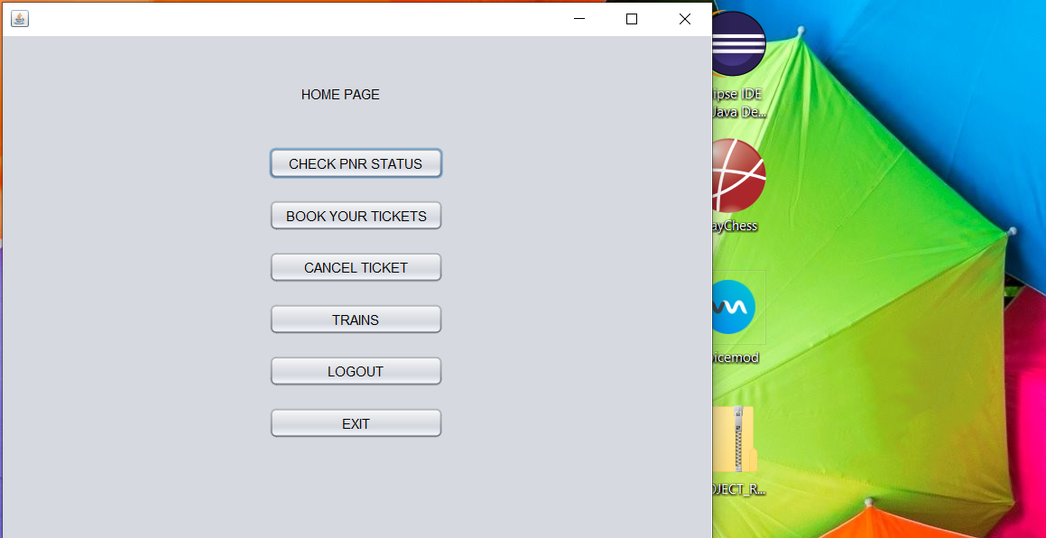

Slide 14
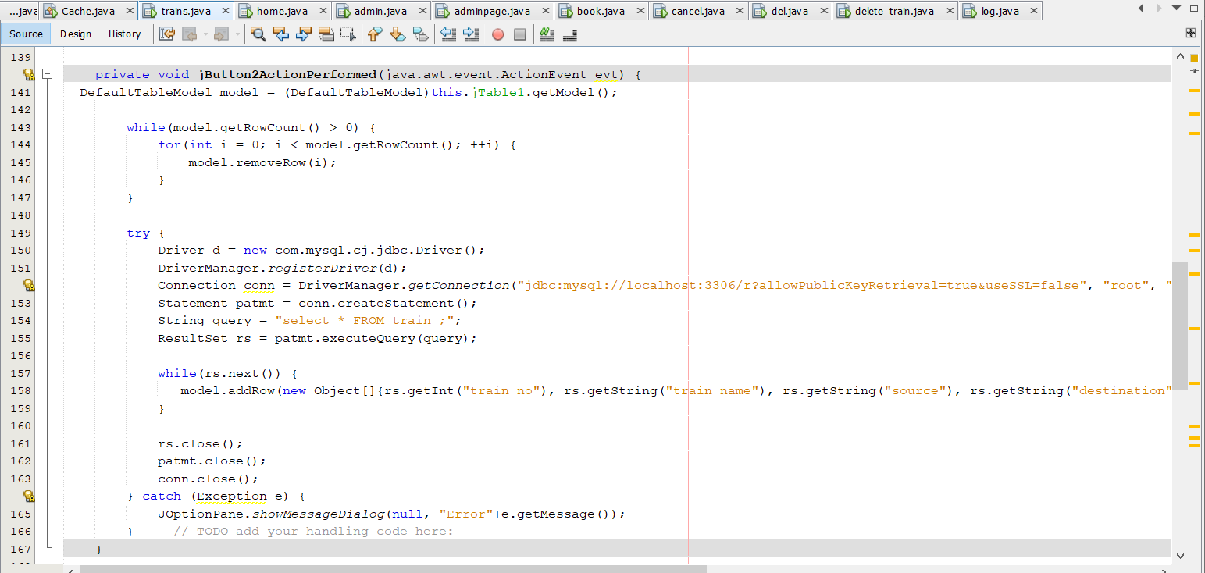
Trains Page

Slide 15
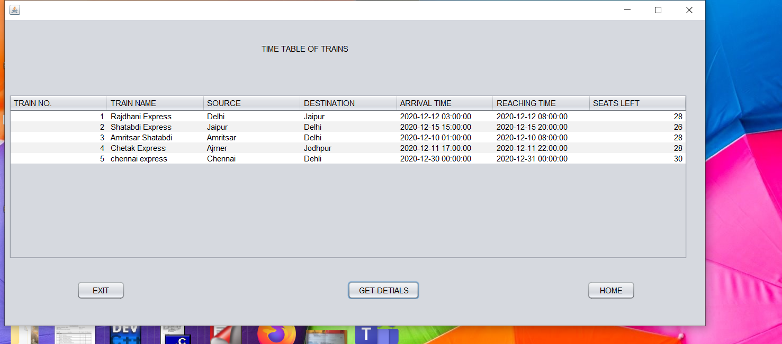

Slide 16
THANK YOU

